Slide 1
Starting the Store

Slide 2
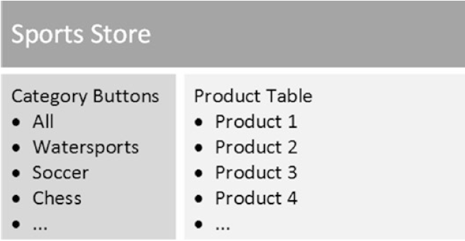
Starting the Store
Now that the data model is in place, we can start to build out the store functionality, which will let the user see the products for sale and place orders for them.
The basic structure of the store will be a two-column layout, with category buttons that allow the list of products to be filtered and a table that contains the list of products:

Slide 3
Creating the Store Component and Template
As you become familiar with Angular, you will learn that features can be combined to solve the same problem in different ways.
We introduce some variety into the SportsStore project to showcase some important Angular features, but we are going to keep things simple for the moment in the interest of being able to get the project started quickly.
With this in mind, the starting point for the store functionality will be a new component, which is a class that provides data and logic to an HTML template, which contains data bindings that generate content dynamically.

Slide 4
Creating the Store Component and Template (continued)
Create a file called store.component.ts in the SportsStore/src/app/store folder with the following code:
import { Component } from '@angular/core';
import { Product } from '../model/product.model';
import { ProductRepository } from '../model/product.repository';
@Component({
selector: 'store',
templateUrl: 'store.component.html'
})
export class StoreComponent {
constructor(private repository: ProductRepository) { }
get products(): Product[] {
return this.repository.getProducts();
}
get categories(): string[] {
return this.repository.getCategories();
}
}

Slide 5
Creating the Store Component and Template (continued)
The @Component decorator has been applied to the StoreComponent class, which tells Angular that it is a component.
The decorator’s properties tell Angular how to apply the component to HTML content (using an element called store) and how to find the component’s template (in a file called store.component.html).
The StoreComponent class provides the logic that will support the template content. The constructor receives a ProductRepository object as an argument, provided through the dependency injection feature.
The component defines products and categories properties that will be used to generate HTML content in the template, using data obtained from the repository.

Slide 6
Creating the Store Component and Template (continued)
To provide the component with its template, create a file called store.component.html in the SportsStore/src/app/store folder and add the following HTML code:
<div class="container-fluid">
<div class="row">
<div class="col bg-dark text-white">
<a class="navbar-brand">SPORTS STORE</a>
</div>
</div>
<div class="row text-white">
<div class="col-3 bg-info p-2">
{{ categories.length }} Categories
</div>
<div class="col-9 bg-success p-2">
{{ products.length }} Products
</div>
</div>
</div>

Slide 7
Creating the Store Component and Template (continued)
The template is simple, just to get started. Most of the elements provide the structure for the store layout and apply some Bootstrap CSS classes.
There are only two Angular data bindings at the moment, which are denoted by the {{ and }} characters.
These are string interpolation bindings, and they tell Angular to evaluate the binding expression and insert the result into the element.
The expressions in these bindings display the number of products and categories provided by the store component.

Slide 8
Creating the Store Feature Module
There isn’t much store functionality in place yet, but even so, some additional work is required to wire it up to the rest of the application.
To create the Angular feature module for the store functionality, create a file called store.module.ts in the SportsStore/src/app/store folder and add he following code:
import { NgModule } from '@angular/core';
import { BrowserModule } from '@angular/platform-browser';
import { FormsModule } from '@angular/forms';
import { ModelModule } from '../model/model.module';
import { StoreComponent } from './store.component';
@NgModule({
imports: [ModelModule, BrowserModule, FormsModule],
declarations: [StoreComponent],
exports: [StoreComponent]
})
export class StoreModule { }

Slide 9
Creating the Store Feature Module (continued)
The @NgModule decorator configures the module, using the imports property to tell Angular that the store module depends on the model module as well as BrowserModule and FormsModule, which contain the standard Angular features for web applications and for working with HTML form elements.
The decorator uses the declarations property to tell Angular about the StoreComponent class, and the exports property tells Angular the class can be also used in other parts of the application, which is important because it will be used by the root module.

Slide 10
Updating the Root Component and Root Module
Applying the basic model and store functionality requires updating the application’s root module to import the two feature modules and also requires updating the root module’s template to add the HTML element to which the component in the store module will be applied.
Modify the app.component.ts file in the src/app folder to read:
import { Component } from '@angular/core';
@Component({
selector: 'app',
template: `<store></store>`
})
export class AppComponent {}
The store element replaces the previous content in the root component’s template and corresponds to the value of the selector property of the @Component decorator.

Slide 11
Updating the Root Component and Root Module (continued)
The following code listing shows the change required to the root module so that Angular loads the feature module that contains the store functionality.
Modify the app.module.ts file in the src/app folder with the following code:
import { BrowserModule } from '@angular/platform-browser';
import { NgModule } from '@angular/core';
import { AppComponent } from './app.component';
import { StoreModule} from './store/store.module';
@NgModule({
declarations: [
AppComponent
],
imports: [
BrowserModule,
StoreModule
],
providers: [],
bootstrap: [AppComponent]
})
export class AppModule { }

Slide 12
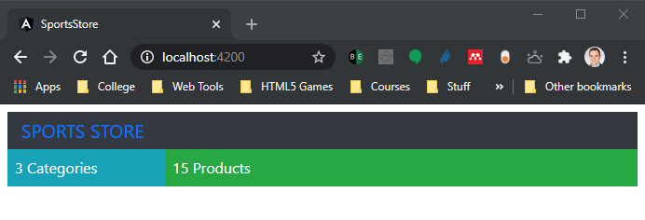
Updating the Root Component and Root Module (continued)
When you save the changes to the root module, Angular will have all the details it needs to load the application and display the content from the store module:

